Slide 1
Computer Vision
Lecture 3
Simon McLoughlin

Slide 2
Overview
Correlation and Convolution
Filtering by convolution
More segmentation – Edge detection

Slide 3
Correlation and Convolution
Correlation and Convolution are two similar (but different) operations in signal processing. We can use them to filter an image to extract more high level information from it.
Convolution is used more because it is associative so it is more computationally efficient when performing multiple filtering operations.
These two operations are linear and shift invariant. They are linear in the sense that the output is a linear combination of the inputs and shift invariant in the sense that we do the same operation as we shift the filter

Slide 4

Correlation
Correlation can be defined for 1D signals by the following formula:
Where F is the filter and I is the signal. Here we assume F has 2N+1 elements, and that these are indexed from -N to N, so that the center element of F is F(0)
What this means is that to calculate the correlation for a single sample of the signal we overlay the filter on that sample, multiply all the filter elements with the signal elements and find the total and that gives us the correlation for that single sample.
We then shift the filter onto the next sample and repeat the procedure. Consider the following example

Slide 5
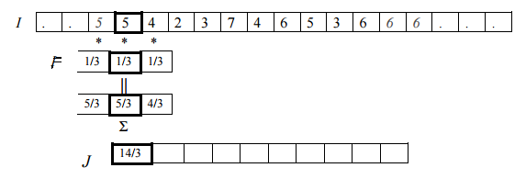
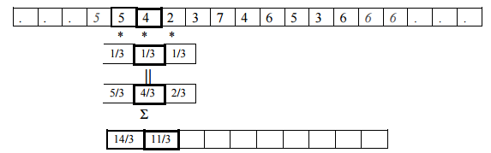
Correlation
Let us consider the example of a simple averaging filter (called a box filter). The discrete representation of this might be Fx=[1/3 1/3 1/3]. This is correlated with the signal as follows
And so on as the filter slides across the signal. How might we perform even more averaging!
shift

Slide 6
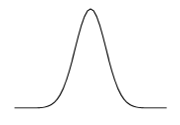

Correlation – Gaussian Smoothing
The averaging filter we just saw is a fairly crude approach to averaging or smoothing. Each sample has the same filter weight applied which means there is a sharp drop-off outside of the filter range
A smoother filter that allows samples closer to the central one to influence the result more would be better.
A common filter for this purpose is the Gaussian filter. Let us first consider it in continuous form (1D)
where μ is the mean and σ is the variance. The value μ controls where the peak is on the x-axis (commonly zero) and σ controls the width of the peak. As σ gets smaller the peak becomes narrower

Slide 7
Correlation – Gaussian Smoothing
To build a discrete Gaussian filter we evaluate the Gaussian function at discrete locations (e.g. -2,-1,0,1,2).
However the Gaussian function goes from -∞ to ∞ but we don’t want to sample it on that range so we figure out what range will give us most of the function (e.g. 99%) and sample it on that range
A 1D Gaussian filter with mean=0 and sigma=1 might be something like [0.05,0.25,0.4,0.25,0.05]

Slide 8
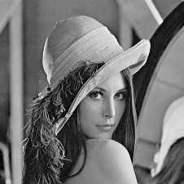
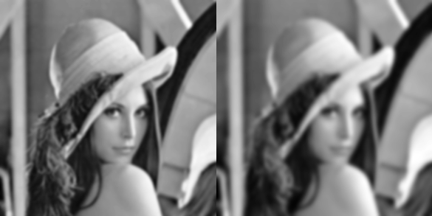
Correlation – Gaussian Smoothing
Original, sigma=3, sigma=5

Slide 9
Correlation and Derivatives
Taking a derivative allows us to measure how quickly something (like an image) is changing.
Intuitively, a derivative is found by taking the difference as we go from one part of a function to another. That is, it’s the change in y divided by the change in x.
Therefore a natural choice for a discrete derivative filter might be F=[-1/2,0,1/2] which when evaluated is J(i) = (I(i+1)-I(i-1))/2 or the change in y divided by the change in x.

Slide 10


Correlation and Derivatives, an example!
Suppose image intensity grows quadratically with position, so that I(x) = x² . Then if we look at the intensities at positions 1, 2, 3, … they will look like:
If we filter this with a filter of the form (-1/2 0 1/2) we will get:
We know that the derivative of I(x), dI/dx = 2x. And sure enough, we have, for example, that J(2) = 4, J(3) = 6, …Notice that J(1) is not equal to 2 because of the way we handle the boundary, by setting I(0) = 1 instead of I(0) = 0. So at the boundary, our image doesn’t really reflect I(x) = x²

Slide 11

2D Correlation
Images are 2D, so we really want to perform correlation in 2D. The basic idea is the same, except that the image and filter are now 2D.
We can assume that our filter is square and has an odd number of elements, so it is represented by a (2N+1)x(2N+1) matrix
Mathematically it is expressed as
Like 1D correlation this just means overlaying the filter on an image point, multiplying all the corresponding values and totalling them.

Slide 12
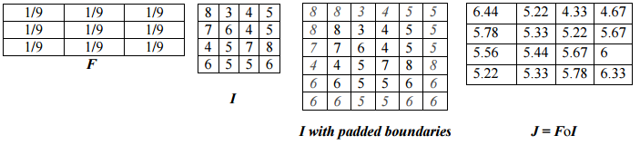
2D Correlation
Here is an example that shows the result of 2D correlation with a 3x3 box filter.

Slide 13


Convolution
Convolution is just like correlation, except that we flip over the filter before correlating. For example, convolution of a 1D image with the filter (3,7,5) is exactly the same as correlation with the filter (5,7,3).
We can write the formula for this as:
Or in 2D where we flip it horizontally and vertically (or rotate by 180 degrees)
Note that correlation and convolution produce the same output when the filter is symmetric

Slide 14
Convolution vs Correlation
The key difference between the two is that convolution is associative. That is, if F and G are filters, then F*(G*I) = (F*G)*I (try a simple example, using F=G=(-1 0 1).
It is very convenient to have convolution be associative. Suppose, for example, we want to smooth an image and then take its derivative.
We could do this by convolving the image with a Gaussian filter, and then convolving it with a derivative filter.
Alternatively we could convolve the derivative filter with the Gaussian to produce a filter called a Difference of Gaussian (DOG), and then convolve this with our image.
The nice thing about this is that the DOG filter can be precomputed, and we only have to convolve one filter with our image.
For this reason convolution is used for filtering in image processing and correlation is used mainly for template matching (later!).

Slide 15
Image Gradients and edge detection
Now that we have covered the background on convolution we can look at some common filters for calculating image gradients and finding edges.
The gradient of an image measures how fast it is changing and in what direction. The magnitude of the gradient tells us how quickly the image is changing, while the direction of the gradient tells us the direction in which the image is changing most rapidly.
We can compute image gradients using correlation or convolution (normally convolution) and an appropriate filter
Naturally areas in the image where the gradient changes most quickly are areas where there is a jump in intensity – edges!

Slide 16
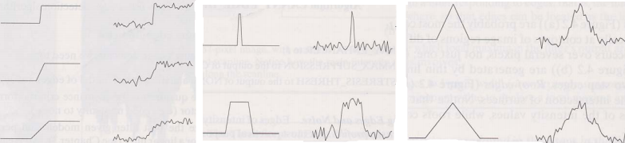
Image Edges
Edges and their detection are just another part of the image segmentation process
Image edges (jumps in intensity) tend to be where something interesting happens, e.g. the boundary of an object against a different background
These may succeed in segmenting an image where other techniques fail (e.g. thresholding)
step
ridge
roof

Slide 17


Computing the Image Gradient
The image gradient is the derivative in both the x and y direction, expressed below as partial derivatives
For a continuous function we can write the partial derivative with respect to x as:
which says that as x changes by an infinitesimal amount ∆x, how does I (the intensity) change?

Slide 18


Computing the Image Gradient
In the discrete case we don’t have infinitesimal amounts, we deal with pixels so we can write it as:
If we wanted to represent the above equations as filters for convolution or correlation we could write them as [-1, 0, 1] and [-1,0,1]’ as we seen already.
We could use these filters to find the gradient in both the x and y directions, however they are sensitive to noise and the most obvious approach to dealing with noise is to average!

Slide 19


Computing the Image Gradient – Prewitt Operator
So we can take our x-direction filter and average it across 3 rows for a more robust estimate of the gradient this leads to a filter like:
And in the y-direction, a filter like:
Now we can convolve these with our image to find the gradient in the x and y directions! These operators are called the Prewitt operators.

Slide 20
Computing the Image Gradient
The x direction operator will result in peaks in the gradient where there is a vertical edge and the y direction operator will gives peaks where there is a horizontal edge but how do we find edges of arbitrary orientation?
If an edge exists in a diagonal direction then it will give rise to local maxima in both the horizontal and vertical gradient image so if we combine these we can find edges of arbitrary orientation
For example an edge with an angle of 45 degrees will have a similar response in both the vertical and horizontal gradients but one that has an angle of 20 degrees will have a higher response in the horizontal than the vertical so we can use the relative responses to find the edge orientation!

Slide 21
Gradient Magnitude and Direction
So the image gradient is a vector with an x and y component, lets call it G = [Gx,Gy]. To find the gradient magnitude we find the magnitude of this vector
Magnitude of G is |G| = sqrt(Gx^2+Gy^2)
We find the direction (lets call it θ) of the gradient the same way we find it for any other vector
The direction of G is θ=tan⁻¹ (Gy/Gx)

Slide 22
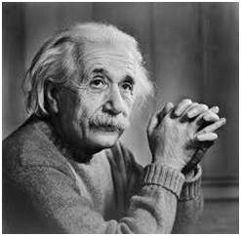
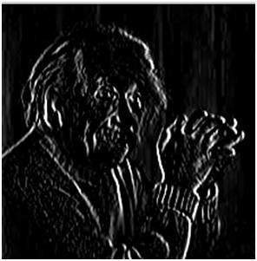
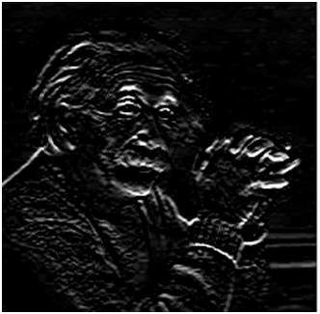
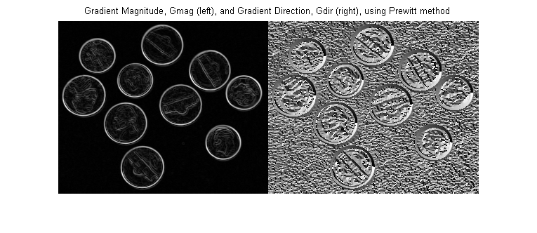
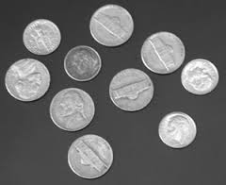
Some example images
Gx
Gy

Slide 23
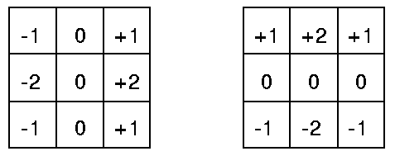
Sobel Operator
The operator we seen earlier is called the Prewitt operator. A popular operator for finding gradients is a very similar operator called the Sobel operator which is better at highlighting edges in different directions (i.e. it is more isotropic than the Prewitt).

Slide 24
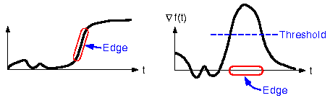
What to do with the image gradient?
Applying these operators produces an image gradient which will enhance edges. However a lot of the time these edges will be quite thick (especially if the image has been smoothed with a low pass filter to remove noise – a common precursor to edge detection)
In addition the gradient image is not binary and the edges will typically form peaks in the gradient
So we need to threshold the image gradient to find good edges and frequently we will have to thin them as well as we really only want them a single pixel thick!

Slide 25
Canny Edge Detection Algorithm
Invented by John F. Canny in 1986, the Canny operator is considered one of the best for finding edges but does come at a price in terms of speed
There are a number of steps involved in Canny Edge Detection
1. Smooth the image (with a Gaussian filter)
2. Find the image gradient (using Prewitt or Sobel kernels)
Implement ‘non-maximum suppression’
Perform Hysteresis Thresholding
We have seen steps 1 and 2 already lets take a closer look at steps 3 and 4.

Slide 26


Non-maximum suppression
As we said already, the smoothing and derivative operations can lead to thick edges that will normally have a peak and then gradually tail off
What we would like to do is thin this edge so it is a single pixel thick. We can do this by scanning the gradient magnitude pixel by pixel and examining the pixels either side of the current pixel along the direction of the gradient
If the gradient magnitude of the centre pixel is higher than its neighbours then leave it unchanged but if its lower than either of its neighbours then set it to 0.
Sometimes
We need to interpolate

Slide 27
Hysteresis thresholding
Most thresholders used a single threshold value which means if the edge values fluctuate above and below this value the line will appear broken.
Hysteresis counters this by setting an upper and lower edge value limit (2 thresholds, T1 and T2).
If a value lies above the upper threshold limit it is immediately accepted. If the value lies below the low threshold it is immediately rejected. Points which lie between the two limits are accepted if they are connected to pixels which exhibit strong response.
Canny recommends the ratio of high to low limit be in the range two or three to one, based on predicted signal-to-noise ratios.

Slide 28
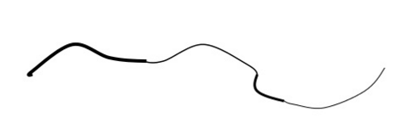
Hysteresis thresholding
You use a high value to start edge curves and a low value to follow them.
One algorithm might be (T1 lower threshold):
1. Obtain a binary image by thresholding the gradient with T1
2. Obtain all the image coordinates (row,col) that have intensities greater than T2.
3. Only keep the connected components in the binary image obtained in step 1 that overlap with the coordinates obtained in step 2 above

